Slide 1
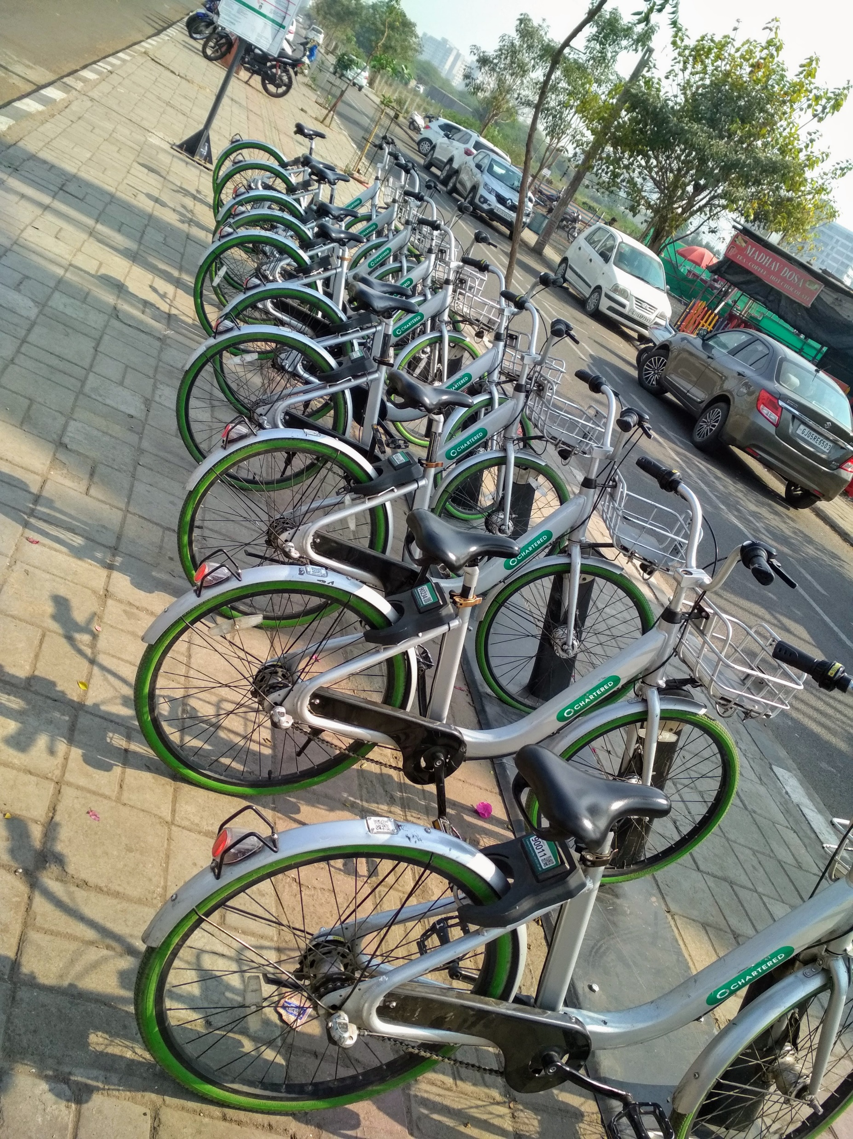

The Downfall of Surat Chartered Bike and Solutions
An analysis of the demise of a green transport solution
Submitted By:
Abhishek Sharma | Isaac Solanki
Saksham Grewal | Bhumi Agrawal
Alok Raj | Tency Trivedi

Slide 3




STEPS INVOLVED
Step 1
Step 2
Step 3
Step 4
Step 5
Step 6
Problem Identification
Data Collection
Analysis
Results
Application of ITS
Conclusion & Discussion

Slide 4
Identification of variables
Last mile connectivity
Enforcement Gaps in Dedicated Cycle Lane Implementation
Awareness Deficiency
Safety Protocols Implementation

Slide 5
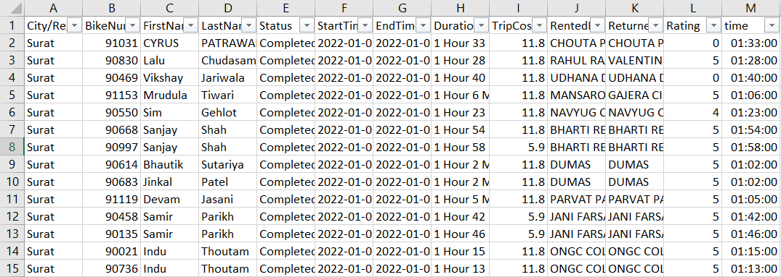
Data Collection - Surat
Way of collection – through Chartered Bike app
Source : http://Charted_bike_SMC_(Surat)

Slide 6
Data Collection - NYC
Way of collection – through Citi Bike app
Source : https://citibikenyc.com/system-data

Slide 7
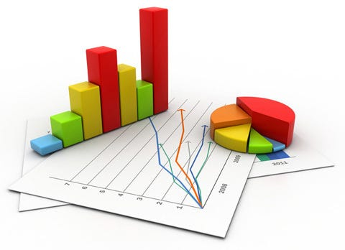
Inference from collected data
Data Volume Dynamics:
Data volume varies, requiring strategic sampling for robust analysis.
Geospatial Precision:
Location data is in latitude-longitude format for spatial analysis in ITS.
Anonymized Demographics:
User profiles lack age and gender, posing challenges in service customization
Environmental Integration:
Temperature sensors enhance weather impact insights on transportation
Bias in User Ratings:
Addressing bias needs advanced algorithms for fair evaluations

Slide 8
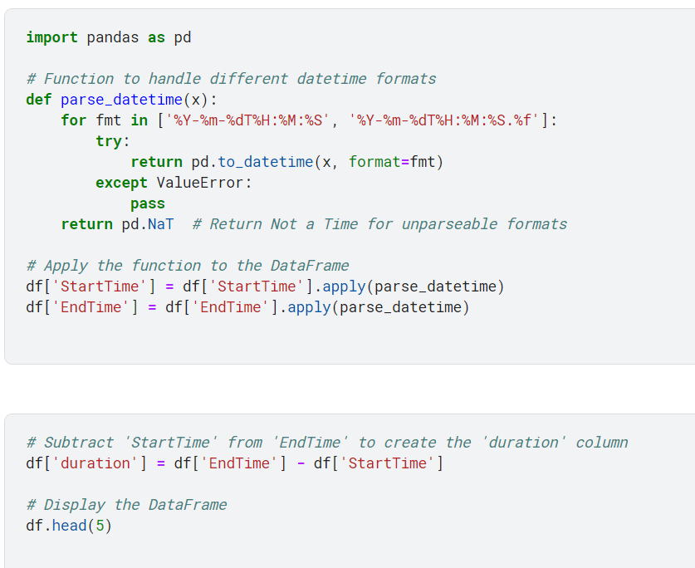
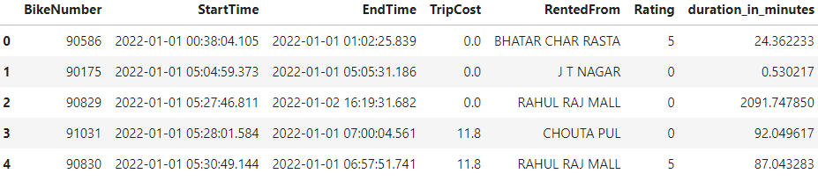
Data Cleaning and Pre processing
Output Table:

Slide 9
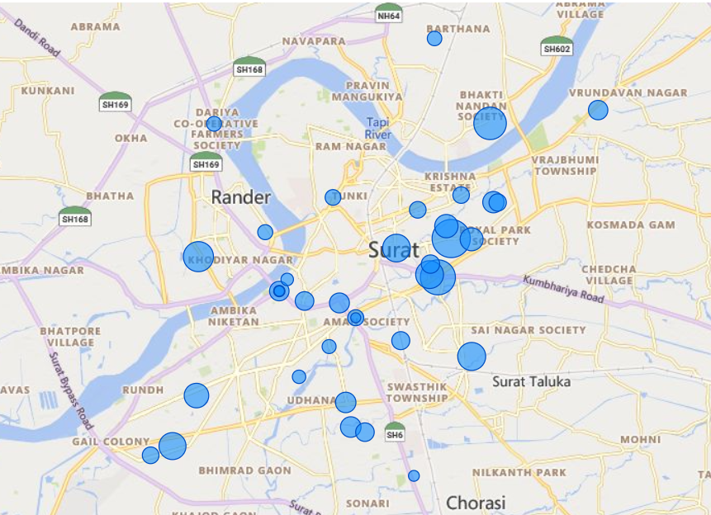
Exploratory Data Analysis

Slide 10
CHARTERED BIKE SNAPSHOT: BIKE SHARE SYSTEM IN SURAT
Faster than a cab and more convenient than BRTS, Chartered Bike was quickly adopted by Suratis and visitors as the best way to get around Surat.
Current System Size
Total Trips taken
Average Trips per month
Total Earnings of 2022 Average Revenue per trip
100 Stations and 1200 pedal bikes
241K
20662
₹ 4,66,180
₹ 1.93

Slide 11
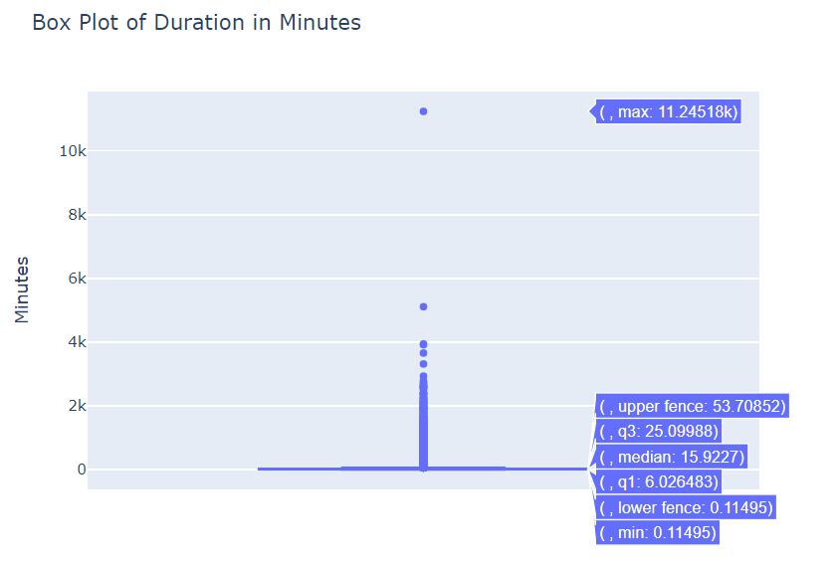
Box Plot of Duration
Observation:
Durations above 53 minutes are abnormal and are considered as outliers
Reason:
Docking Problem
Site error

Slide 12
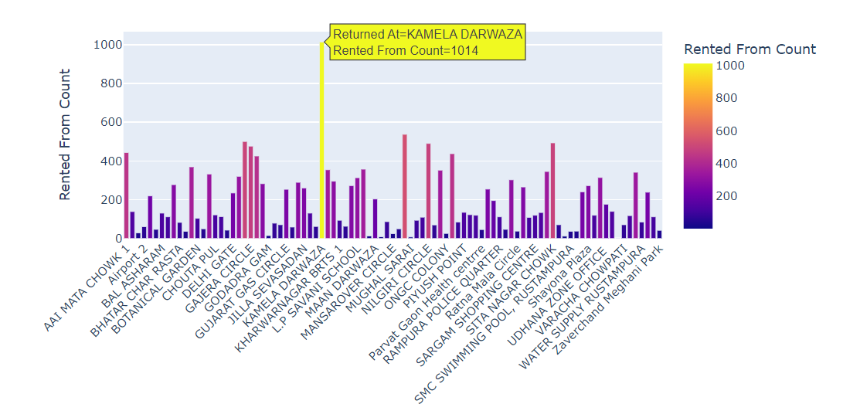
Stations with Abnormal Duration
Observation:
Highest no. of Abnormal trips are recorded at Kamela Darwaza
Solution:
Priority of repairing with accordance to no. of docking problems.

Slide 13
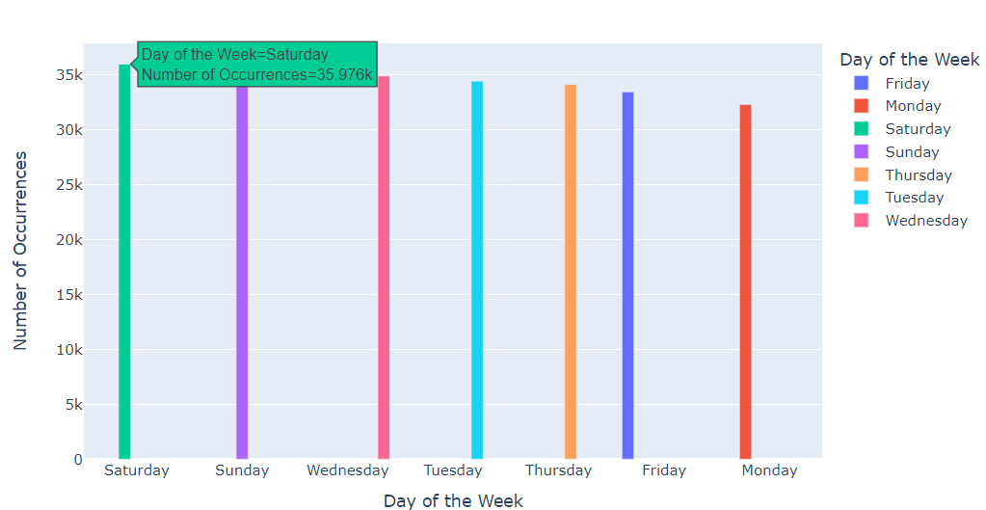
No. of trips by Week Day
Observation:
Users are highly active on Saturday
The lowest use is on Monday
Reason:
Youth participation

Slide 14
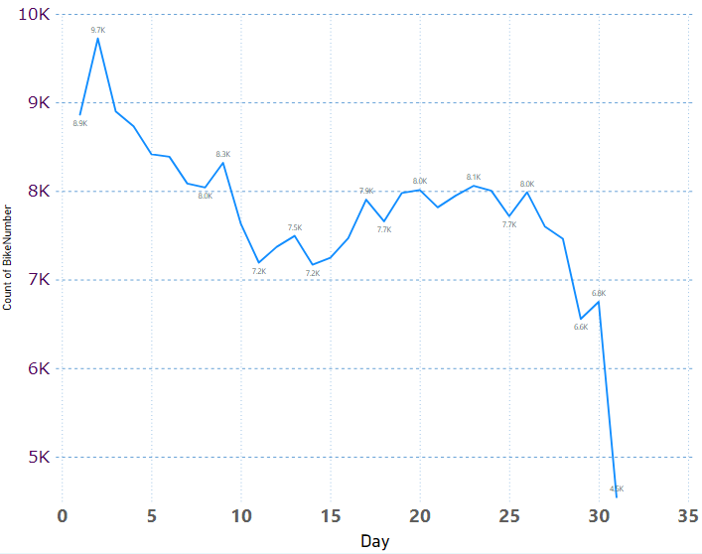
No. of Trips by Day of Month
Observation:
Users are highly active during the first week of the month
The lowest use is in the mid of the month

Slide 15
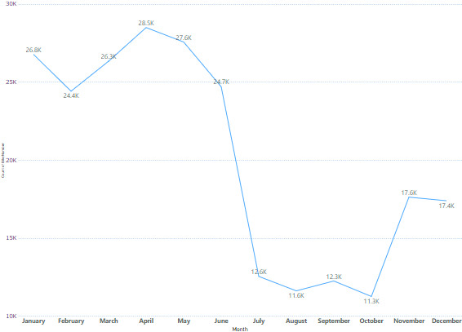
No. of Trips by Month
Observation:
Highest ridership in month of April
Low usage during July to October as it is monsoon
Reason:
Due to onset of summer
Due to festival season

Slide 16
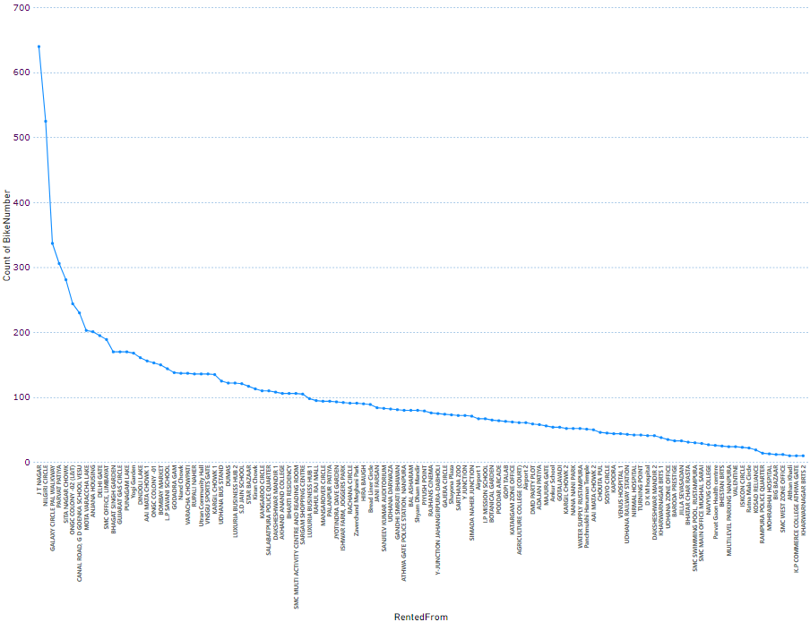
Start Station Trip Distribution
Observation:
JT Nagar has highest demand
Convention Hall has the lowest demand
Solution:
More docking stations

Slide 17
User Ratings
Observation:
Average user ratings are 4 out of 5
Reason:
Complex UI
Lazy user nature
Lack of benefits

Slide 18
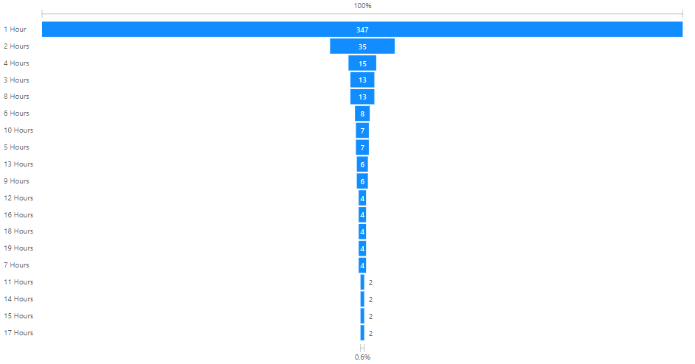
No. of Trips by Abnormal Duration
Observation:
Most trips have duration of 1 hour or less
All trips greater than 1 hour shouldn’t have taken place
Reason:
Free trips under 30 minutes

Slide 19
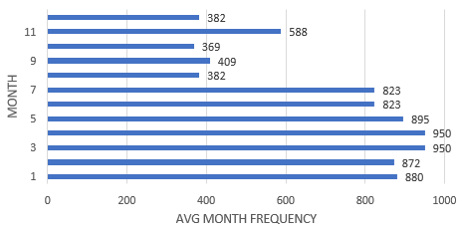
Average Monthly Trips
Observation:
March and April have the highest average no. of trips
September, October and November have low average no. of trips
Reason:
Due to onset of summer
Due to festival season

Slide 20
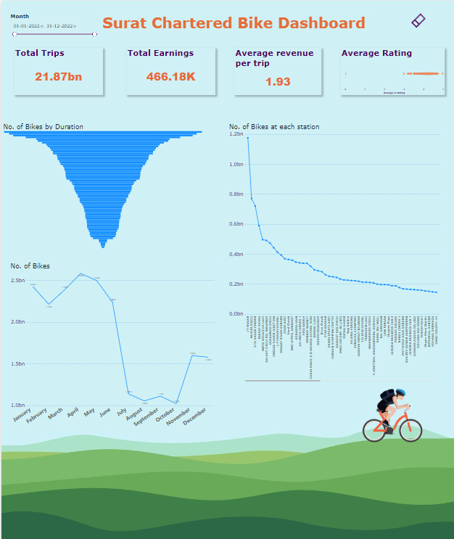
Results

Slide 21
Solution for chartered bike
Downtime maintenance
Customer-centred Services
Value-added Services
Schedule repairs, inspections, and cleaning during low-demand periods to minimize disruptions and ensure upkeep
Includes order tacking, product configuration and customization as well as security/trust
These are extra services such as online auctions and online training and education

Slide 22
Solution for chartered bike
Downtime maintenance
Non-BRTS access
Value-added Services
Schedule repairs, inspections, and cleaning during low-demand periods to minimize disruptions and ensure upkeep
Establish bike stations in areas where BRTS stations are impractical, improving access to distant locations for commuters
These are extra services such as online auctions and online training and education

Slide 23
Solution for chartered bike
Downtime maintenance
Non-BRTS access
Incentive-driven program
Implementing reduced fares for daily users and introducing incentive schemes such as coupons or gift vouchers for achieving set milestones
Schedule repairs, inspections, and cleaning during low-demand periods to minimize disruptions and ensure upkeep
Establish bike stations in areas where BRTS stations are impractical, improving access to distant locations for commuters

Slide 24
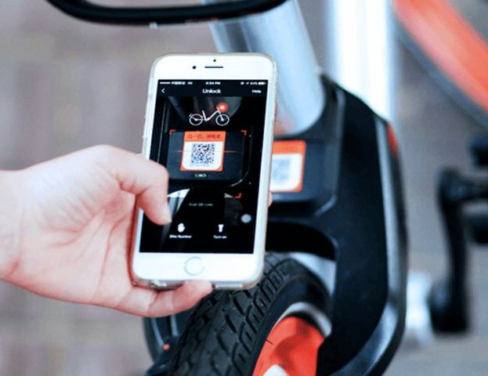
Application of ITS in improving PBS
ATCAG (Automated Tracking and Control of Green Assets)
Integration with Urban Infrastructure
Data-Driven Decision Making
Smart Locking Systems

Slide 25
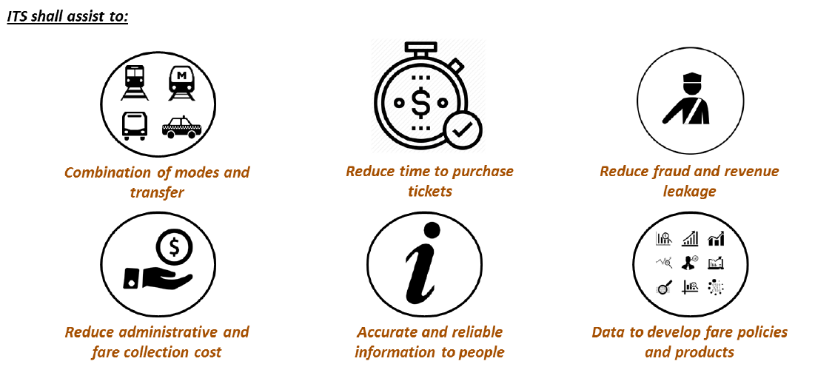
INTEGRATED FARE SYSTEM
The Integrated Ticketing System aims to promote the use of public transport in Surat (SMC) by making ticketing system easy and attractive.

Slide 26
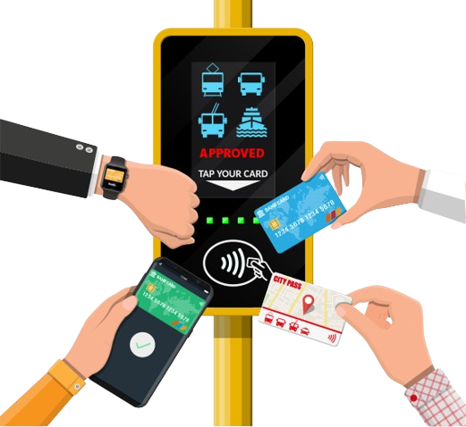
Layered Automated Fare Collection(AFC) Architecture for ITS
Level-0: Fare mediums with passengers (smart cards, mobile phones, wearables, etc.)
Level-1: Passenger-facing devices (TVMs, TOMs, Fare Gates, Fare Readers, etc.)
Level-2: Station/depot level servers for data aggregation
Level-3: Public Transport Operator (PTO) level servers for data collection and reconciliation
Level-4: Common ITS server managed by central scheme operator for tap aggregation, fare calculation, and banking transactions

